Slide 1

DEPART OF ELECTRONICS AND COMMUNICATION
MAJOR PROJECT PRESENTATION ON
“AI POWERED EYE FOR VISUALLY CHALLENGED PEOPLE”
SUBMITTED BY: PROJECT GUIDE:
CHANDANA M T [4MO22EC004] Miss . Prashobe Gowthami K H
MONISHA G B [4MO22EC013] Assistant Professor
SRIKANTH K R [4MO22EC024] Dept. of ECE,MYCEM
VAISHNAVI C G [4MO22EC031] Mysore

Slide 2
PRESENTATION OVERVIEW
ABSTRACT
INTRODUCTION
PROBLEM STATEMENT
PROPOSED SOLUTION
OBJECTIVES
LITERATURE SURVEY
HARDWARE AND SOFTWARE REQUIREMENTS
BLOCK DIAGRAM
WORKING PRINCIPLE
ADVANTAGES
APPLICATIONS
RESULT
CONCLUSTION

Slide 3
ABSTRACT
AI-powered eye system designed for visually challenged individuals.
Raspberry Pi 4 used as the main processing unit.
Camera module captures real-time images of surroundings.
AI algorithms perform object, text, and face recognition.
Detected information converted into speech using TTS technology.
Provides audio feedback to help users navigate safely and independently

Slide 4
INTRODUCTION
Many people around the world are visually challenged and face daily difficulties.
They need tools to help them move around and understand their surroundings.
Traditional aids like canes and guide dogs have limitations.
Artificial Intelligence can help by recognizing objects, people, and text.
An AI-powered eye uses a camera and voice to describe what’s around.

Slide 5
PROBLEM STATEMENT
Visually challenged individuals face difficulty in recognizing surroundings.
Limited access to portable assistive vision devices.
Existing systems lack real-time object and text detection capabilities.
Difficulty in identifying known persons without visual assistance.
Need for a compact AI-based solution using Raspberry Pi.
Requirement for audio feedback to enhance safe navigation.

Slide 6
PROPOSED SOLUTION
Use Raspberry Pi 4 as Central Processing Unit.
Employ Camera Module for Real-Time Image Capture.
Integrate MobileNetSSD for Object Detection and Recognition.
Implement Tesseract OCR for Text Extraction from Environment.
Add Face Recognition Module for Identifying Known Individuals.
Convert Detected Information into Speech Using TTS Module.
Provide Audio Output Through Speaker or Headphones for User Assistance

Slide 7
OBJECTIVES
Help visually challenged people easily understand their surroundings.
Detect nearby objects, text, and faces using a camera.
Give clear, real-time audio feedback.
Assist with safe and smooth navigation.
Improve user independence and daily life.
Build a smart ,easy-to-use system.

Slide 8
LITERATURE SURVEY
Sl No | Authors | Title | Year | Description
01 | Bharath Kumar T and shree Lakshmi M | Smart glasses for the visually impaired using ESP32. | 2017 | This study proposed wearable smart glasses system that integrates sensor , camera, and audio output to assist visually impaired users.
02 | Al-Mamun M A And Rahaman M M | Blind Aid an intelligent assistant for visually impaired people | 2019 | This paper presented a vision based system for blind user using Raspberry pi ,open cv and speech feedback
03 | P. N. Shinde, V. Honmane, V. Jadhav, S. Nigade, and D.Suryawanshi. | Assistive vision technologies for the visually impaired | 2024 | A comprehensive literature survey, ITSI Transactions on Electrical and Electronics Engineering
04 | Kumar S and sahoa G. | Al-Based wearable Devices for visually impaired people | 2020 | This research implemented wearable system using yolo object detection algorithm and text to speech technology.
05 | L. Manirajee, S. Q. H. Shariff, and S. M. M. Rashid | Assistive technology for visually impaired individuals | 2024 | The survey highlights current research trends and suggests future directions for developing more user-friendly, reliable, and affordable assistive technologies.

Slide 9
HARDWARE REQUIRMENTS
Raspberry Pi 4
USB camera
Portable Power Bank
Earphones
SOFTWARE REQUIREMENTS
Raspberry Pi OS
Python 3.7 or higher
OpenCV
PyTesseract OCR engine
Tesseract-OCR binaries
MobileNetSSD model files
Text-to-Speech libraries
NumPy for numerical computations

Slide 10
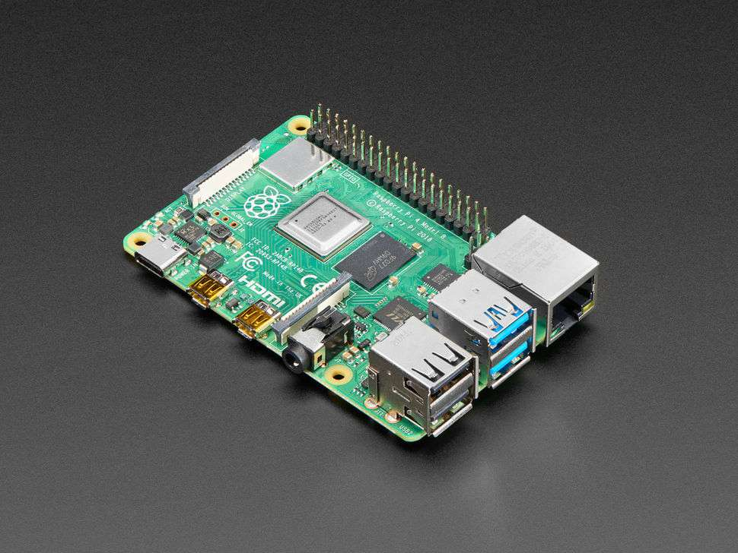
RASPBERRY PI 4
The Raspberry Pi 4 is a small, credit‑card–sized computer designed to run powerful tasks like AI, image processing, and real‑time applications.
The quad‑core processor gives fast performance for running AI tasks.
Camera and USB support allow easy connection of sensors and input devices.
Built‑in Wi‑Fi and Bluetooth enable smooth wireless communication.
Multiple RAM options help handle image processing efficiently.

Slide 11
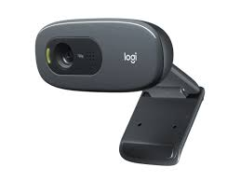
USB CAMERA
Captures real‑time video input for processing by the Raspberry Pi.
Provides clear and stable images needed for text, face, and object detection.
Easy to connect and power through USB, making the system simple and portable

Slide 12
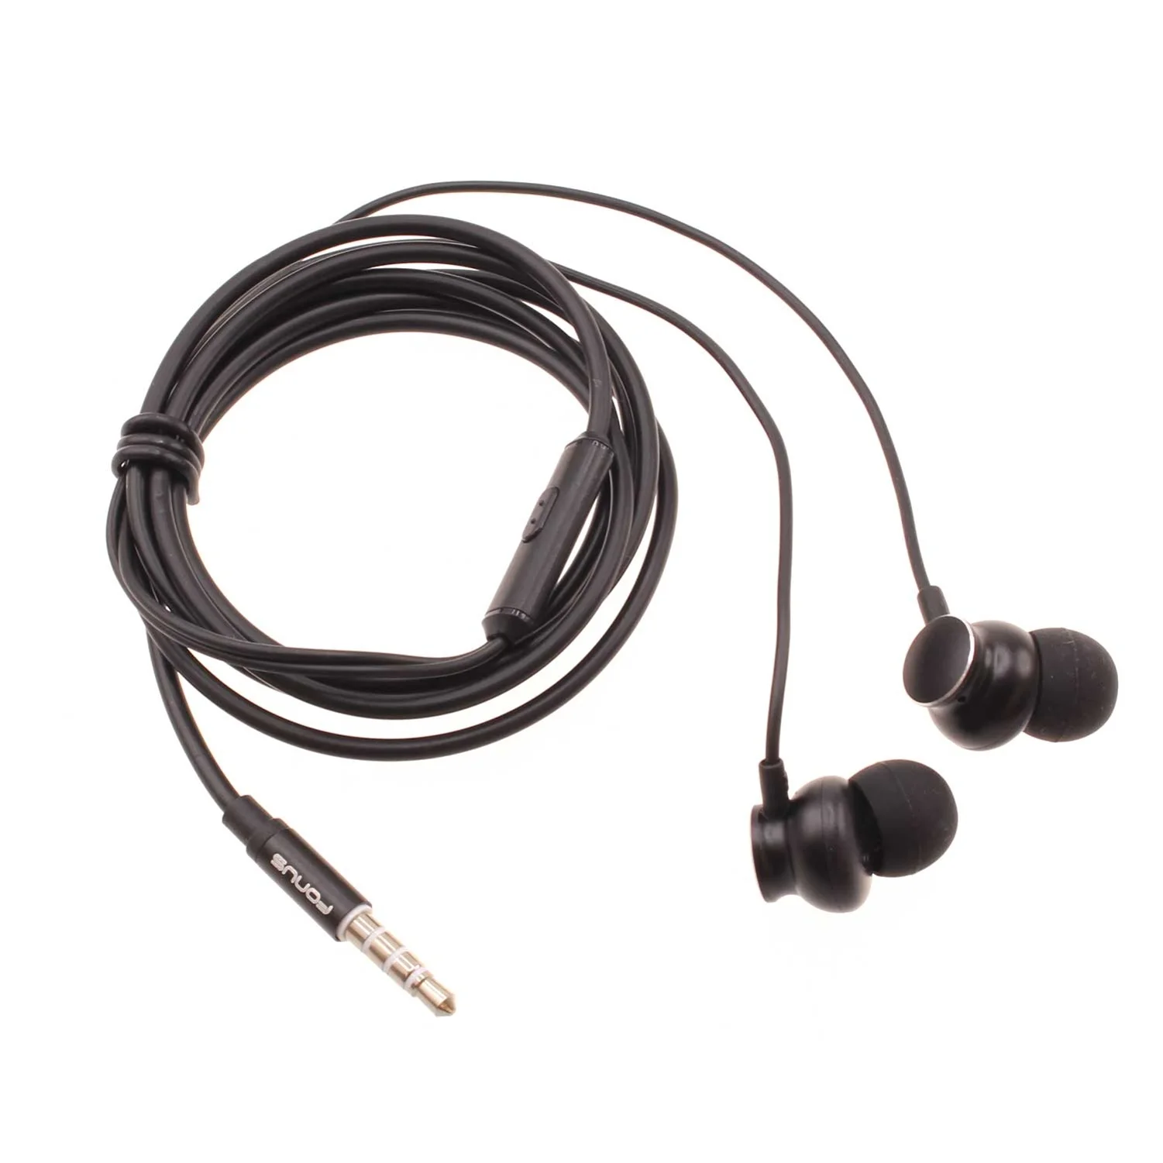
EARPHONES
Earphones provide clear real‑time audio feedback to the user based on what the system detects.
They allow the user to receive information privately without disturbing others.
Earphones help visually challenged users navigate independently by delivering instant spoken guidance.

Slide 13
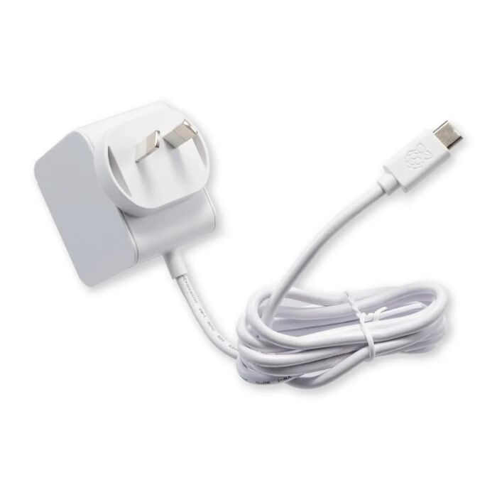
POWER SUPPLY
Powered Using 5V, 3A Battery.
Provides Stable Power for Raspberry Pi 5 and Peripherals.
Ensures Reliable Performance for AI and Vision Projects.
Portable and Suitable for Mobile Applications

Slide 14
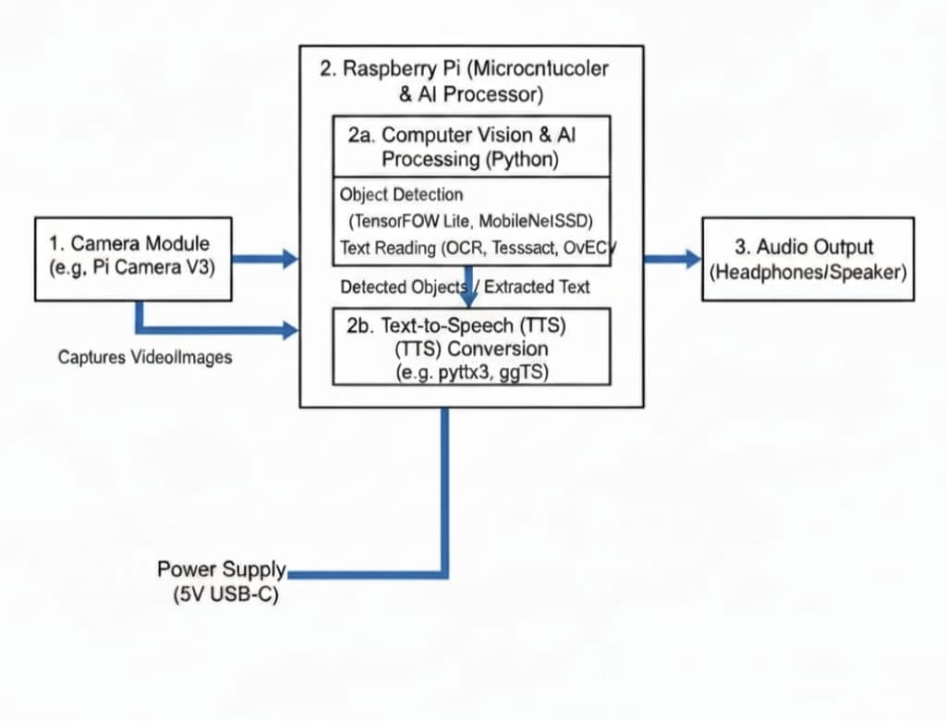
BLOCK DIAGRAM

Slide 15
WORKING PRINCIPLE
Capture Real-Time Images Using Camera Module
Process Images on Raspberry Pi 4
Perform Object Detection Using YOLOv5
Recognize Text from Objects Using Tesseract OCR
Provide Audio Feedback via Text-to-Speech Module
Integrate Vision and Speech Modules for Real-Time Assistance
Test and Validate System Performance in Real Environment

Slide 16
ADVANTAGES
Helps identify objects in front of the user
Detects obstacles and supports safe walking.
Reads text aloud (books, signboards, currency, labels).
Improves independence in daily activities.
Provides real-time guidance through audio or vibration.
Recognizes faces of family, friends, and others.
Warns about dangers like vehicles or uneven roads.
Helps in shopping by identifying products and colors.

Slide 17
APPLICATIONS
Object detection – Identifies objects around the user.
Obstacle detection – Alerts about nearby obstacles.
Navigation assistance – Guides the user while walking.
Text reading (OCR) – Reads printed or written text aloud.
Face recognition – Helps recognize known people.
Scene description – Gives a short description of the surroundings.
Shopping assistance – Identifies products, labels, and colors.
Currency recognition – Detects and announces currency value.

Slide 18
RESULT

Slide 19
CONCLUSION
The system successfully helps visually challenged people understand their surroundings.
AI enables accurate object detection, text reading, and obstacle identification.
Real-time audio or vibration feedback increases user safety and mobility.
The solution reduces dependence on others and promotes independence.
Low-cost hardware like Raspberry Pi makes the system affordable and practical.

Slide 20
THANK YOU!!

